Slide 1
Binus University
COMP6696001 - Research Methodology in Computer Science
ADVISOR
STUDENT
Puti Andam Suri S.Kom M.TI
Muhamad Fajar S.Kom M.Kom
Vito Xavier - 2540110602
Eldwin Felice - 2540110861
Axel Valent - 2540110741
A Comparative Study of Machine Learning Approaches for Rice Yield Prediction in Sumatera

Slide 2
Table of
Contents
I
Introduction
II
Related Works
III
Research Methodology
IV
Results
V
Conclusion

Slide 3
Introduction
Based on data from Statista, Indonesia is one of the largest rice consuming countries in the world with a total consumption of 35.6 tons of rice in 2021/2022.
Multiple sources indicate that Indonesia produces relatively little rice, just enough to cover national consumption, with very little for surplus and export
This makes Indonesia vulnerable to a decline in rice production especially in the midst of climate change and food shortages.
Thanks to current technological developments, we can take advantage of machine learning technology to predict crop yields to ensure national food security and increase rice yield in Indonesia
This study aims to evaluate and compare several different linear and nonlinear regression techniques as well as the effect of PCA on variables, to find the most appropriate and accurate regression model for predicting rice yields in Sumatra.

Slide 4
Related Works
Title | Author | Publication Year | Insight
Selection of important features for optimizing crop yield prediction | Maya Gopal P S and Bhargavi R | 2019 | Forward selection algorithms performed best. And with the importance of irrigation and water supply for the growth of rice, data regarding irrigation and water supply might be important for the prediction of rice
Sugarcane crop yield forecasting model using supervised machine learning | R. A. Medar, V. S. Rajpurohit, and A. M. Ambekar | 2019 | Some attributes can be predicted using other methods such as time series forecasting or prediction using other attributes. Naive Bayes performs better than other 3 algorithms for weather conditions and soil attributes, and SVR-RBF performs better for predicting NDVI and crop yield.
Mustard Yield Prediction using Machine Learning Approach | A. Goyal and A. Vashisth | 2021 | Feature extraction with Principal Component Analysis (PCA) performed better than Stepwise Multiple Linear Regression (SMLR),. A hybrid model may perform better than individual models if each model can support the shortcomings of the other
Enhancing crop yield prediction utilizing machine learning on satellite-based vegetation health indices | H. T. Pham, J. Awange, M. Kuhn, B. V. Nguyen, and L. K. Bui | 2020 | The research results indicate that machine learning models with PCA have higher accuracy than without PCA. This study has also uncovered that, due to climate data being a type of time-series data, it is very vulnerable to data redundancy. One technique that can overcome this problem is Principal Component Analysis or PCA. Many of the studies found by H. T. Pham, et al. performed PCA on a linear regression model, knowing there is still the possibility of a nonlinear relationship within the data.
LINEAR REGRESSION MODEL TO STUDY THE EFFECTS OF WEATHER VARIABLES ON CROP YIELD IN MANIPUR STATE | B. Bhattacharyya, R. Biswas, Sujatha K. and D.Y. Chiphang | 2021 | The amount of rice harvested was significantly affected by the harvest area and many climatic parameters. Multiple linear regression can produce fairly accurate predictions based on climate data

Slide 5
Related Works
Title | Author | Publication Year | Insight
Predicting crop yields in Senegal using machine learning methods | A. B. Sarr and B. Sultan | 2022 | In this study, it has been proven that in general, types of nonlinear regression such as Random Forest, SVM, and Neural Network provide better accuracy values compared to LASSO which is a type of linear regression.
Design And Implementation Of Crop Yield Prediction Model in Agriculture | S. Gowda and S. Reddy | 2020 | Polynomial Regression and Random Forest Regression perform better than Decision Tree, therefore Polynomial Regression and Random Forest Regression could be strong candidates for nonlinear regression research.
Machine learning methods for crop yield prediction and climate change impact assessment in agriculture | A. C. Droesch, A. Kassahun, and C. Catal | 2018 | Neural network algorithms were used to produce models that use semiparametric variance from deep neural networks, Combining machine learning with domain area knowledge from empirical studies improves predictive skills, while changing conclusions about the impact of climate change on agriculture.
A HYBRID APPROACH FOR CROP YIELD PREDICTION USING MACHINE LEARNING AND DEEP LEARNING ALGORITHMS | S. Agarwal and S. Tarar | 2021 | This paper uses SVM, LSTM, and RNN for crop yield prediction which achieved and accuracy of 97%, which is better compared to another previous paper which achieved an accuracy of 93% using RF and ANN
Why Comparing Single Performance Scores Does Not Allow to Draw Conclusions About Machine Learning Approaches | N. Reimers and I. Gurevych | 2018 | Considering the random nature of non-deterministic models such as Random Forest Regression and MLP Regression, results from different iterations of model training may vary, therefore the mean of results from different iterations of model training are required in order to capture the non-deterministic nature of Random Forest and Neural Networks. This issue may be solved through the usage of 5-fold Cross-Validation

Slide 6
Research Methodology
Datasets
Device
Google Colab with free GPU Accelerator
Scikit-Learn Library in training and evaluating Machine Learning models
Sumatera Rice Plant from Kaggle by Ardika Satria in January 2023
Contains rice crop production from 8 provinces in Sumatra in 1993-2020
224 rows each consisting of 7 columns which are Province, Year, Production Yield, Production Area, Rainfall, Humidity, and Average Temperature
Source: https://www.kaggle.com/datasets/ardikasatria/datasettanamanpadisumatera
Models
Multilinear Regression
LASSO Regression
Polynomial Regression
Support Vector Regression
Random Forest Regression
Multi-layer Perception (MLP) Regressor

Slide 7
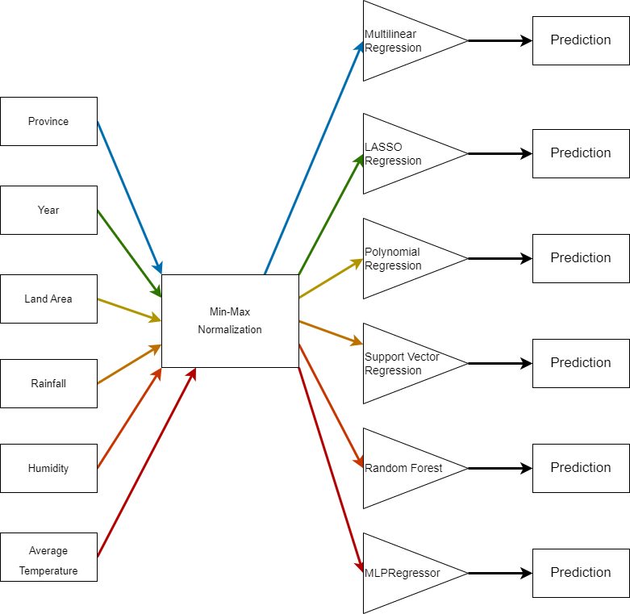
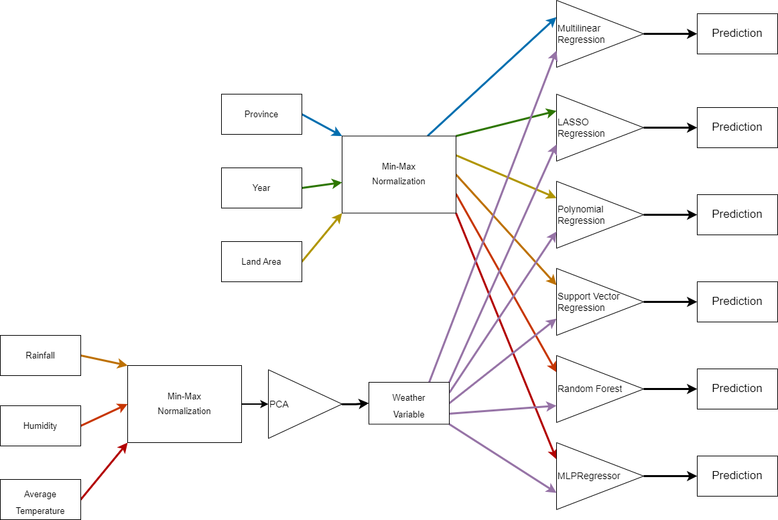
Research Methodology
First Experiment
Second Experiment

Slide 8
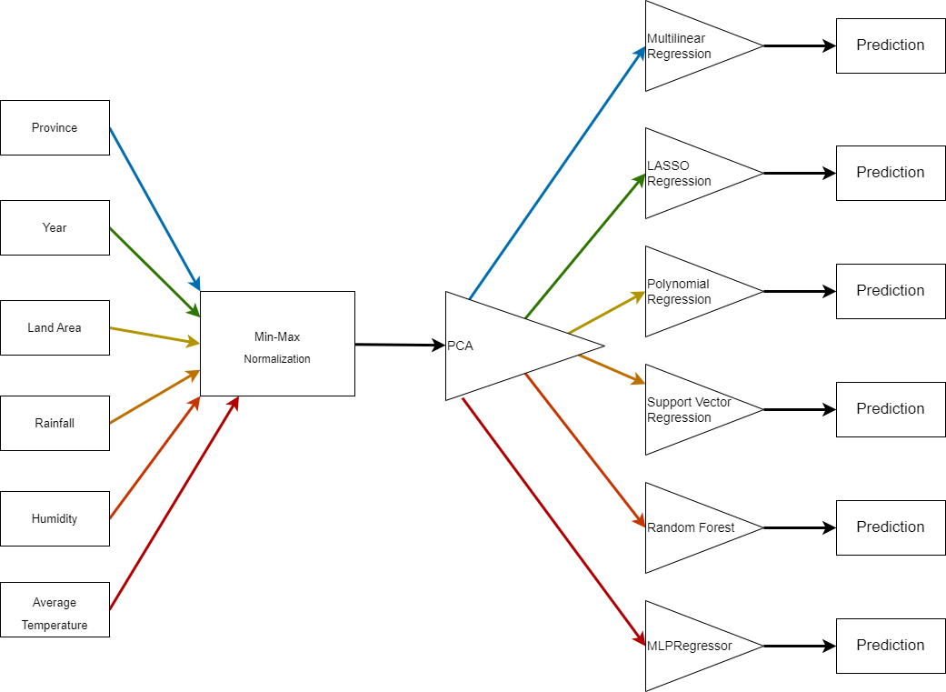
Research Methodology
Third Experiment

Slide 9
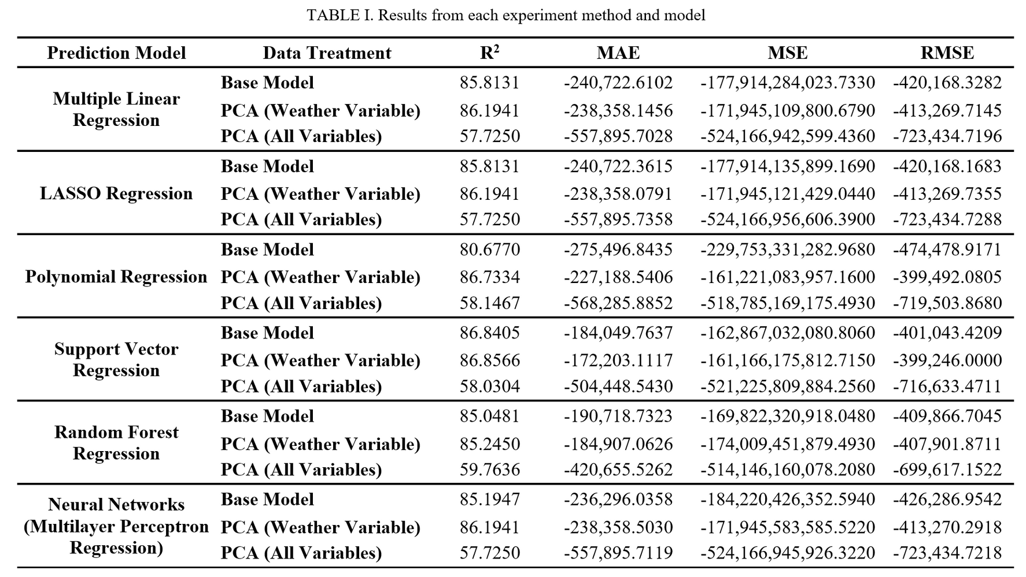
Result

Slide 10
Result
Experiment shows that SVR performed best with an R² value of 86.8566
For base models, SVR performed best with an R² value of 86.8405
For PCA on all variables, Random Forest Regression performed best with an R² value of 59.7636
All models are able to provide good performance seen from the consistency of the results
The usage of PCA on a selection of features may increase performance, but the application of PCA on all variables show a significant decrease in performance, which may allude to a loss of information from the features as a result of dimensionality reduction.

Slide 11

Conclusion
Predicting rice production in Indonesia is crucial for agricultural industry development.
Although the results of this experiment show promising results, further analysis reveals the linear nature of the data provided by the datasets
Further data mining and analysis for agricultural and climatic data in Indonesia may reveal more about the characteristics of crop growth in Indonesia. This could lead to more accurate models for predicting rice and other crops in Indonesia.

